Slide 1
恶意代码分析与防治技术 第14章: 恶意代码网络行为分析
王志
zwang@nankai.edu.cn
南开大学 网络空间安全学院
2023-2024学年

Slide 2
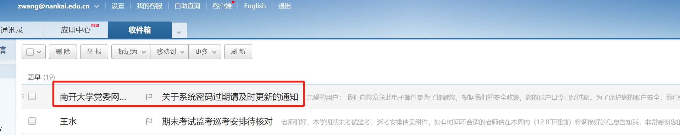

Slide 3
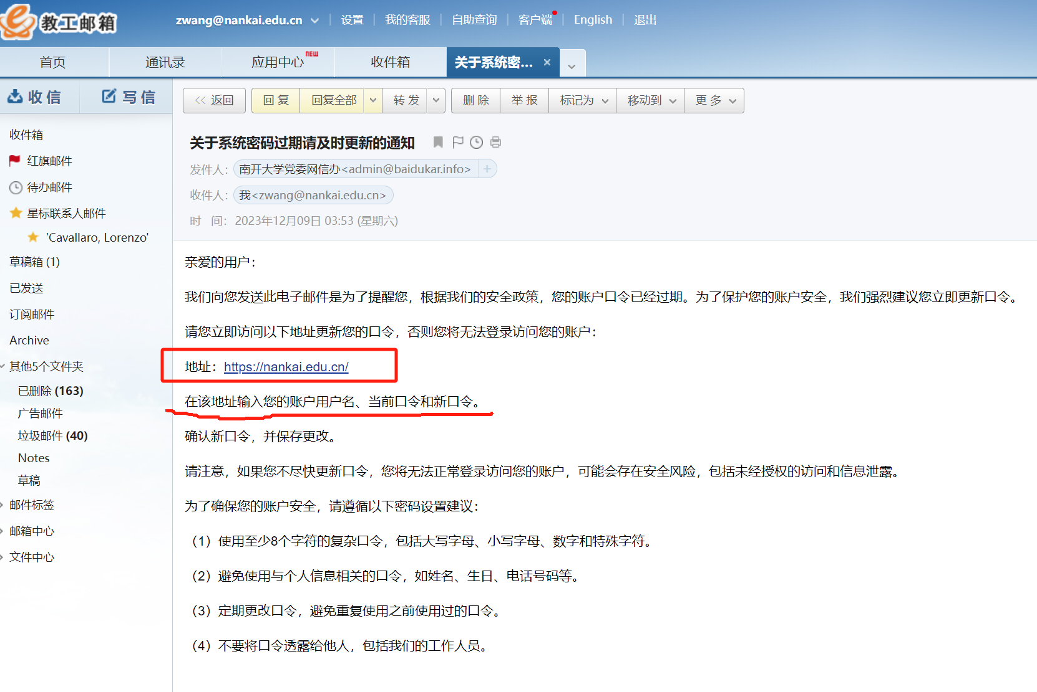

Slide 4
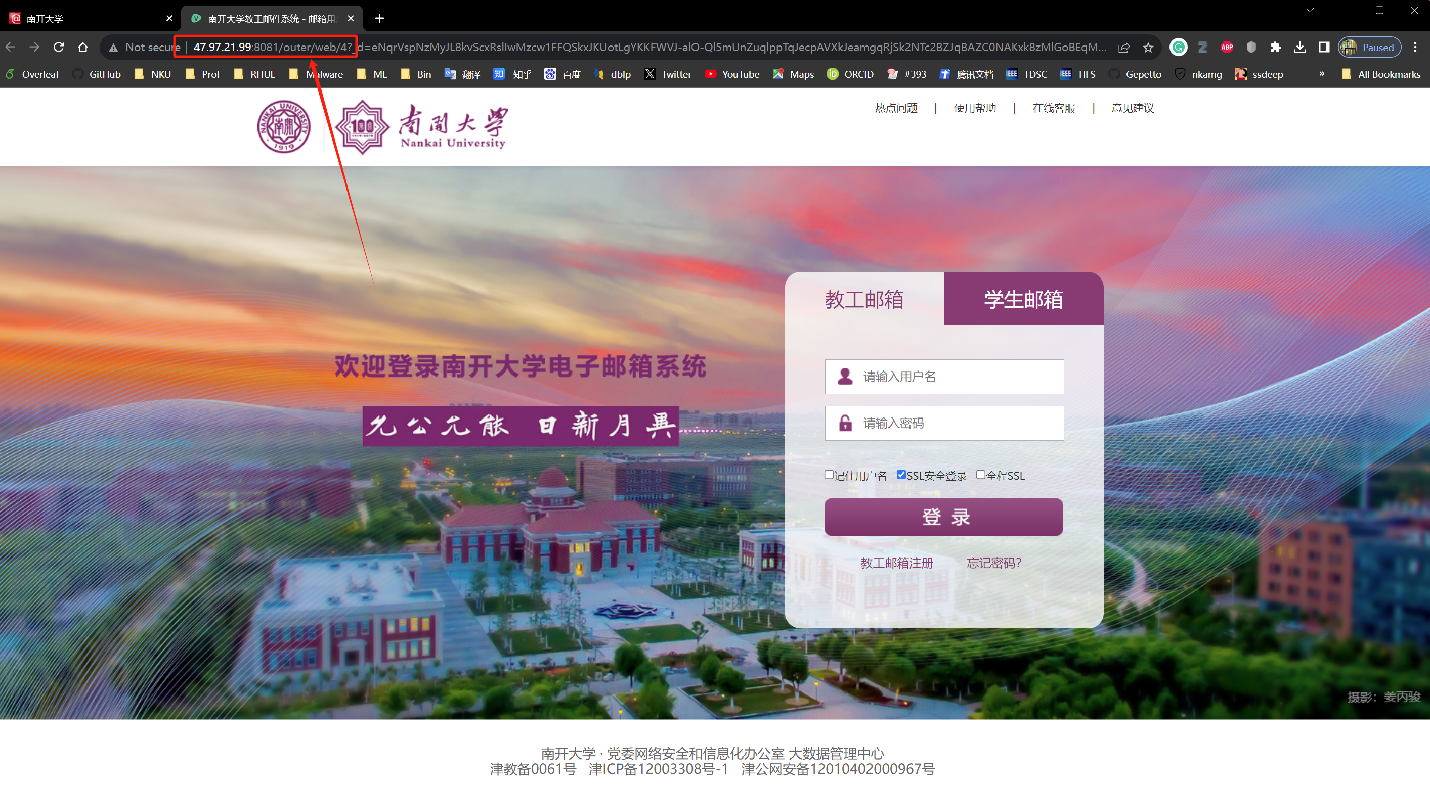

Slide 5
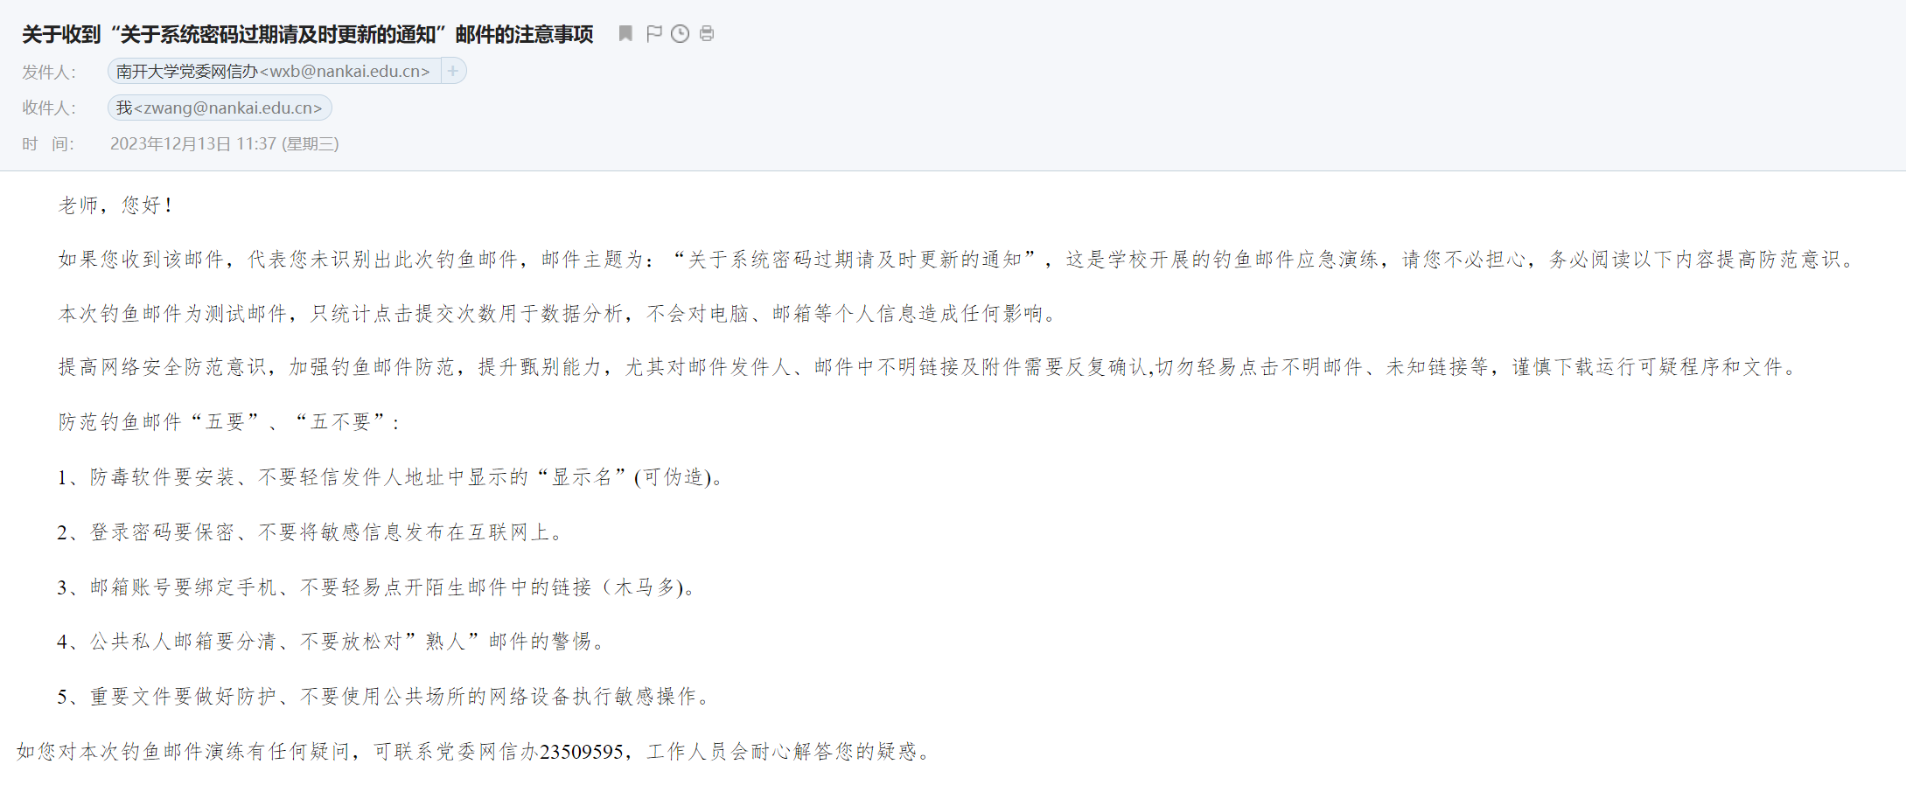
网络钓鱼（Phishing）

Slide 6
本章知识点
网络应对措施（Network Countermeasures）
网络事件调查（Safely Investigate an Attacker Online）
基于内容的防治（Content-Based Network Countermeasures）
动静结合分析（Combining Dynamic and Static Analysis Techniques）
攻击者角度分析（Understanding the Attacker’s Perspective）

Slide 7
网络应对措施 Network Countermeasures

Slide 8

主观题
10分
针对恶意代码的网络行为，目前有哪些检测工具？
正常使用主观题需2.0以上版本雨课堂
作答

Slide 9
Common Network Countermeasures
防火墙、路由器（Filtering with firewalls and routers）
By IP address, TCP and UDP ports
DNS服务器（DNS Servers）
Resolve malicious domain names to an internal host (a sinkhole )
DNS sinkhole
代理服务器（Proxy servers）
Can detect or prevent access to specific domains

Slide 10
网络数据
IP地址
TCP和UDP的端口号（ports）
域名（domain names）
数据包（traffic content）

Slide 11
DNS沉洞（ DNS Sinkhole）
DNS沉洞技术（DNS Sinkhole、网络沉洞、沉洞服务器、黑洞DNS) 是指在网络中的某一域名被判定为恶意域名后，由安全厂商或运营商将其原本解析到的IP地址变更到无害IP地址的技术。
检测、阻挡有害流量、自动程序以及不需要的流量，例如控制WannaCry病毒的蔓延、打击僵尸网络；
监测当前已经失陷的主机数量和状态

Slide 12
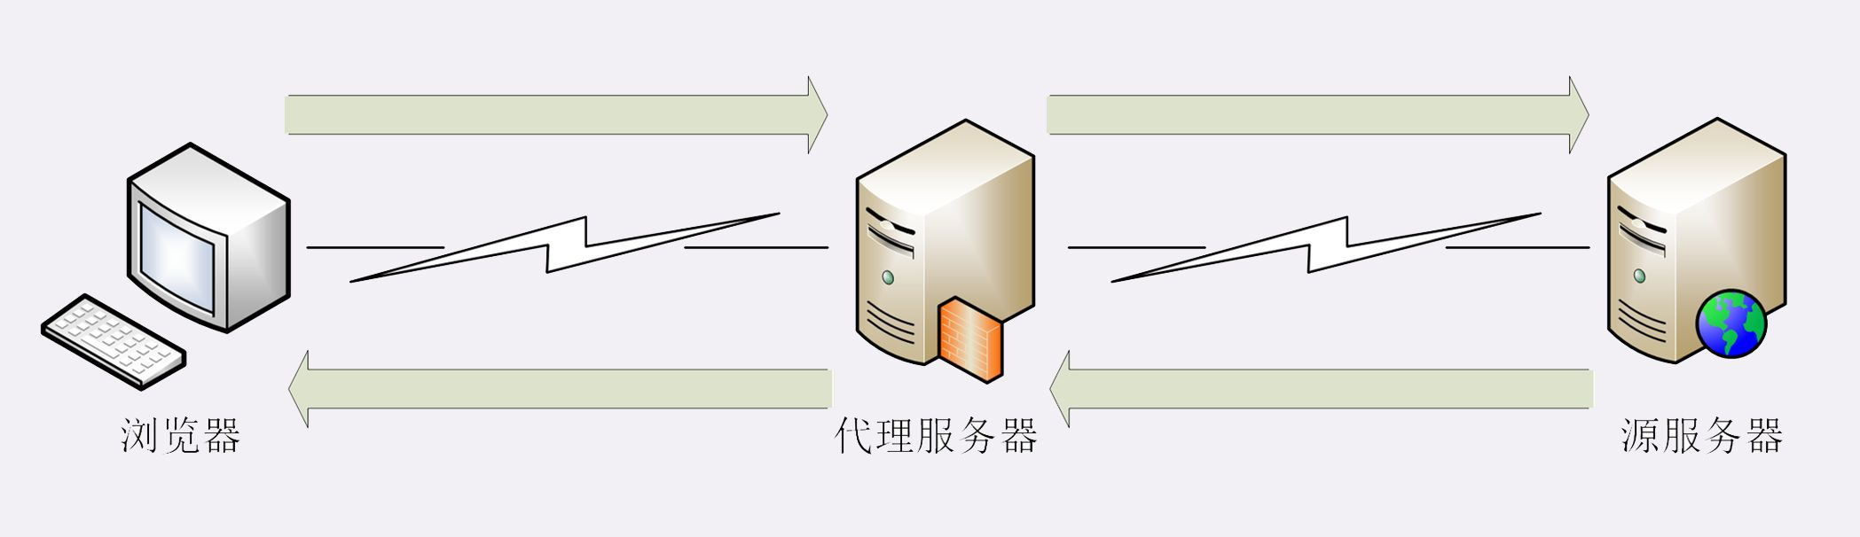
代理服务器（Proxy server）
代理服务器（Proxy Server）用来代理用户去取得网络信息
网络信息的中转站
多用户、缓存、监控、过滤

Slide 13
Content-Based Countermeasures
深度数据包检测（DPI，Deep Packet Inspection）
入侵检测系统（IDS ，Intrusion Detection System)
入侵防御系统（IPS ，Intrusion Prevention System)
邮件代理（Email Proxy）
Web代理（Web Proxy）

Slide 14
主观题
10分
讨论：入侵检测系统IDS和入侵防御系统IPS有什么区别？
作答

Slide 15
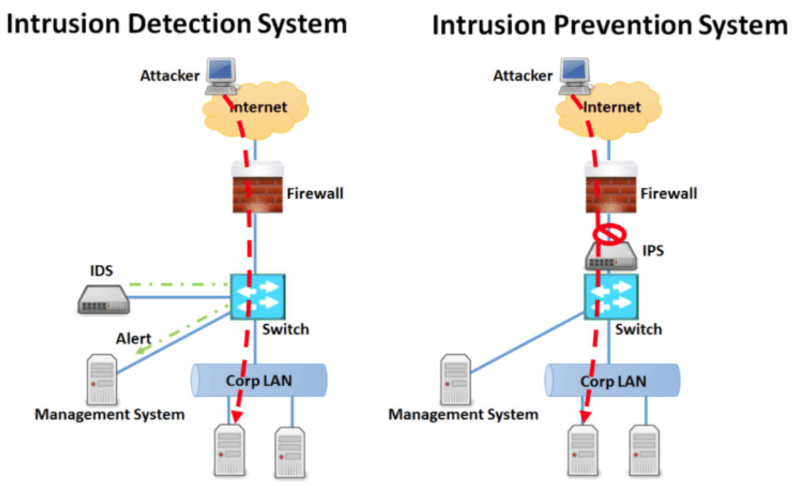
IDS vs IPS
入侵检测系统 (IDS)
被动监听网络数据，旁路部署
检测可疑或恶意流量
入侵防御系统 (IPS)
主动过滤网络数据，串联部署
所有流量都必须通过该设备才能继续到达目的地
检测到恶意流量后，IPS 会中断连接并丢弃会话或流量

Slide 16
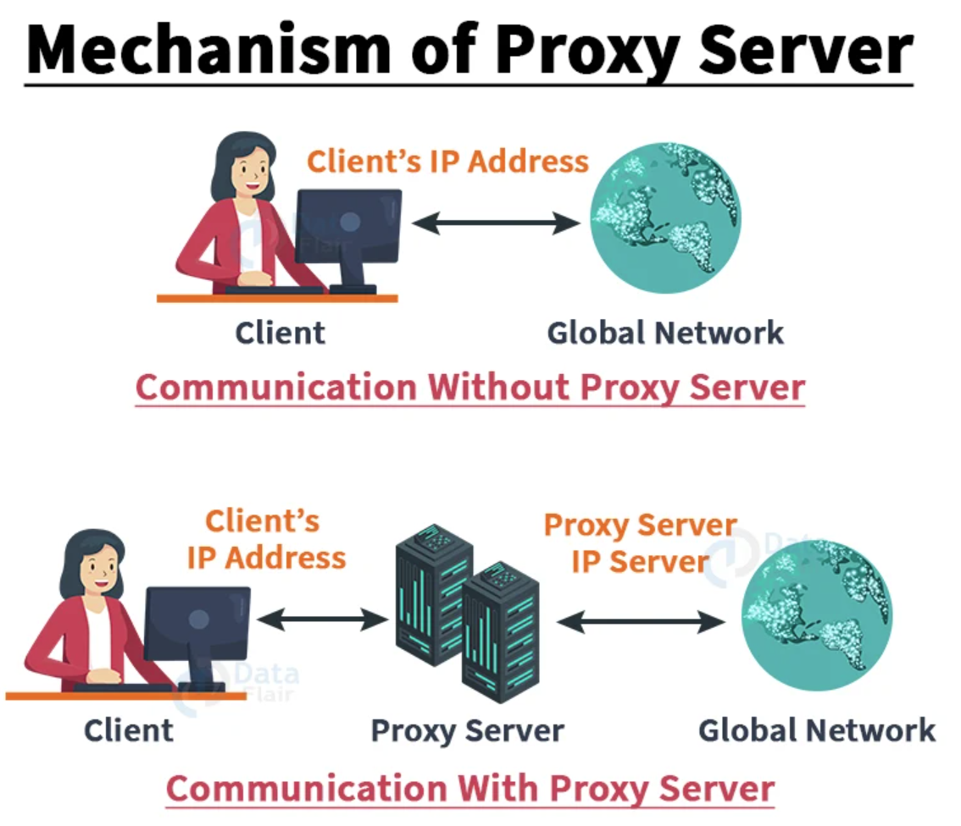
代理服务器
Email Proxy
Web Proxy

Slide 17
Observing the Malware in Its Natural Habitat
Before static or dynamic analysis
Mine logs, alerts, and packet captures generated by malware in its original location

Slide 18
真实环境 vs. 实验室环境
Live-captured data is the most accurate
Some malware detects lab environments
Real traffic contains information about both ends（双向网络流量）
infected host and C&C server
Passively monitoring traffic is more stealthy
OPSEC (Operational Security)

Slide 19
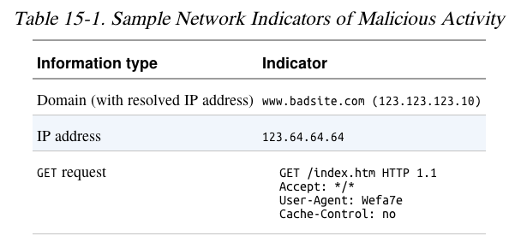
Indications of Malicious Activity

Slide 20
OPSEC
运营安全（OPSEC）
OPSEC是风险管理中使用的一种策略，从竞争对手或敌人的角度查看操作或项目。
If attackers are aware of investigation, attackers may change tactics and effectively disappear.

Slide 21
OPSEC
Preventing adversaries from obtaining sensitive information
Running malware at home may alert attackers
Who expected it to be run in a company
Investigate vs. Reveal
Different from advance static analysis
Reveal personal details about investigator to the attacker.（个人信息泄露）

Slide 22
Identify Investigative Activity
Send spear-phishing email with a link to a specific individual
Watch for access attempts outside the expected geographic area
Design an exploit that logs infections
In a blog comment, Twitter, etc.
Embed an unused domain in malware
Watch for attempts to resolve the domain

Slide 23
Safely Investigate an Attacker Online

Slide 24
主观题
10分
如何避免在分析恶意代码的过程中被攻击者发现？
正常使用主观题需2.0以上版本雨课堂
作答

Slide 25
间接策略（Indirection Tactics）
Proxy server, Tor, Web-based anonymizer
Not subtle—it's obvious that you are hiding
Use a dedicated VM for research
Hide its location with a cellular or VPN connection
Use an ephemeral cloud machine
Such as an Amazon E2C virtual machine

Slide 26
搜索引擎Search Engines
Usually safe
If the domain was previously unknown to the search engine, it may be crawled
Clicking results still activates secondary links on the site
Even opening cached resources

Slide 27
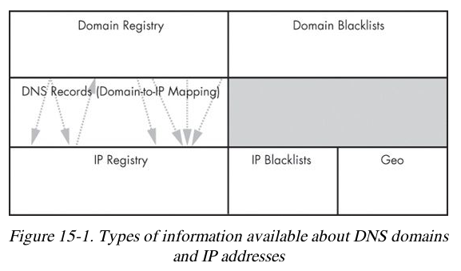
Getting IP Address and Domain Information

Slide 28
Command-Line vs. Web-Based Lookups
Command-Line
whois and dig can be used, but they will expose your IP address
Web-Based
Websites that do the query for you provide anonymity
May give more information

Slide 29
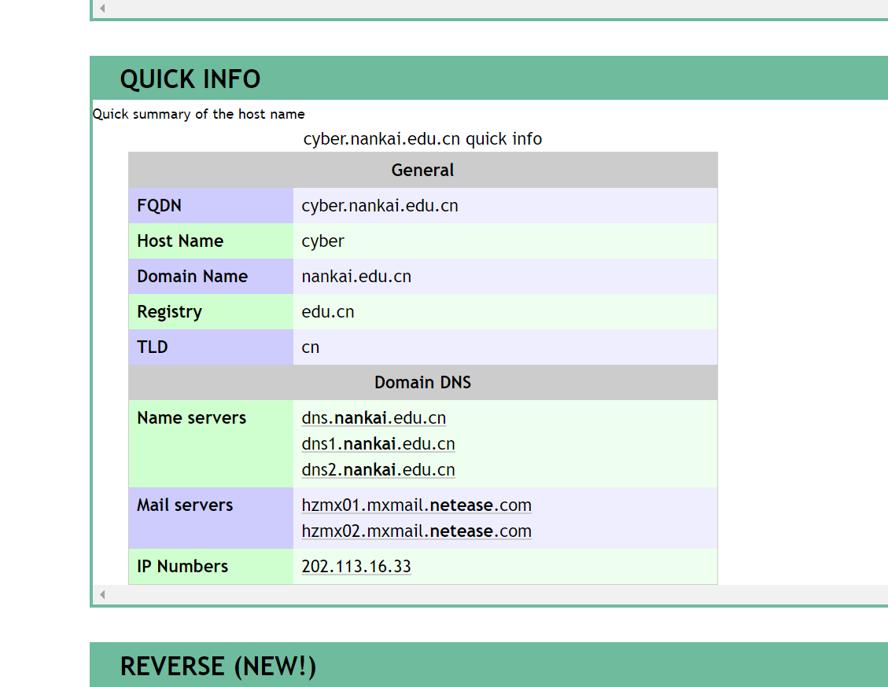
RobTex
Finds multiple domain names that point to a single IP address
Checks blacklists

Slide 30
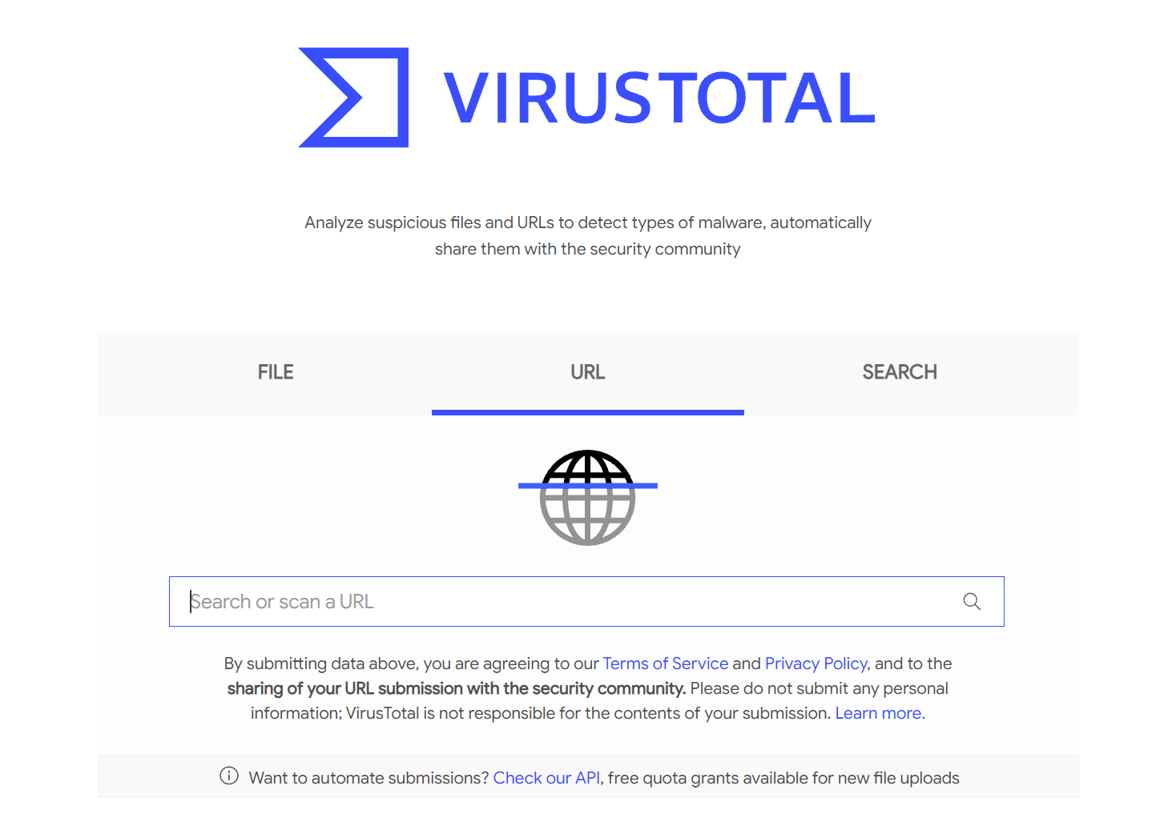
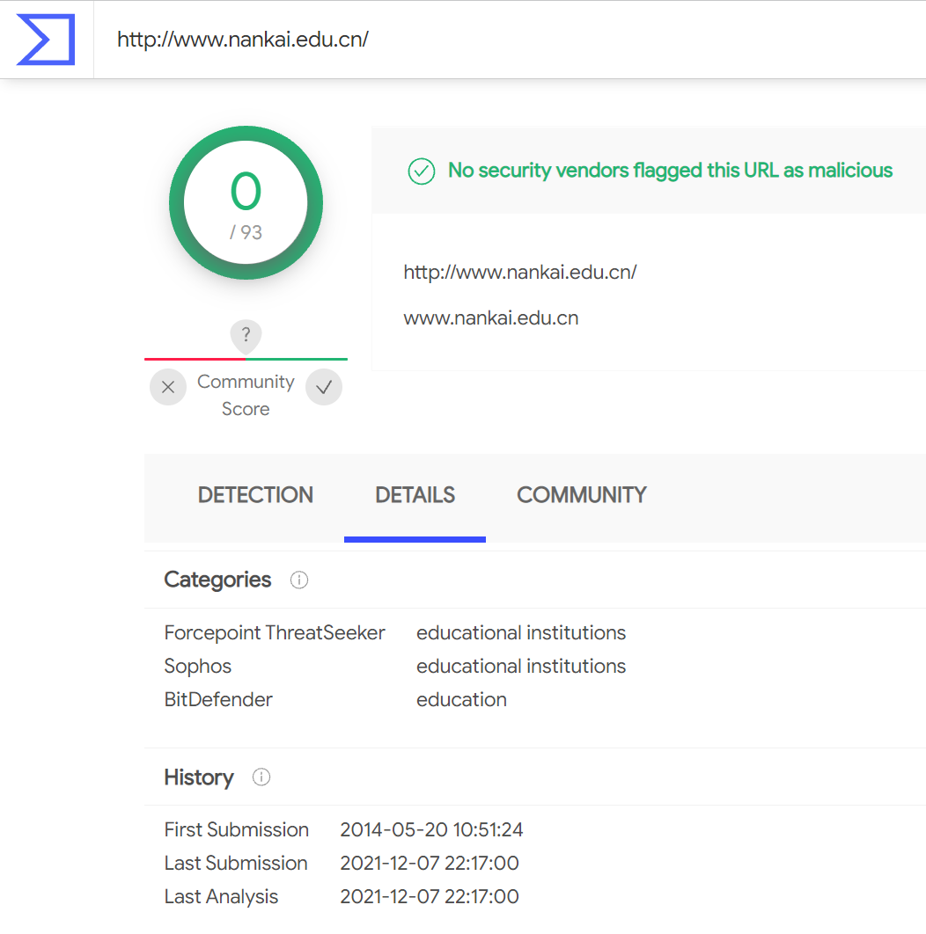
VirusTotal

Slide 31
Content-Based Network Countermeasures

Slide 32
主观题
10分
网络流量中有哪些内容（content）可以用来检测恶意代码的网络行为？
正常使用主观题需2.0以上版本雨课堂
作答

Slide 33
Intrusion Detection with Snort
Rule-based detection, can use:
TCP or IP headers
Size of payload
Connection state (such as ESTABLISHED)
Layer 7 payload data

Slide 34
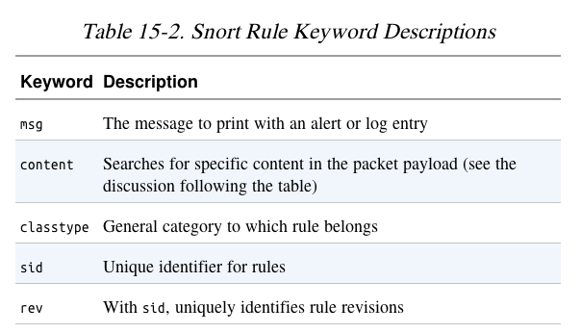
Snort Rule to Block HTTP Traffic by User-Agent

Slide 35
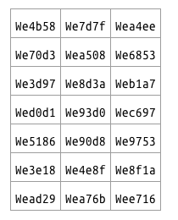
Taking a Deeper Look
Running the malware several times shows these User-Agent strings
Rules can be fine-tuned to capture the malware without false positives

Slide 36
Combining Dynamic and Static Analysis Techniques

Slide 37
主观题
10分
如何进一步提升恶意代码网络行为的特征质量，例如特征的准确度和持续性？
（more accurate and longer-lasting signature）
正常使用主观题需2.0以上版本雨课堂
作答

Slide 38
Two Objectives of Deeper Analysis
Full coverage of functionality using dynamic analysis
Provide new inputs to drive the malware down unused paths
Using iNetSim or custom scripts
Understanding functionality, including inputs and outputs
Static analysis finds where and how content is generated
Dynamic analysis confirms the expected behavior

Slide 39
Effective and Robust Signature
Differentiate between regular traffic and the traffic associated with malware
Why this is a big challenge ?
The evolution of malware is rapid.
Mimic Existing Protocols, Use Existing Infrastructure, Leveraging Client-Initiated Beaconing

Slide 40
Hiding in Plain Sight
Attackers mimic existing protocols
Often HTTP, HTTPS, and DNS, no more IRC
HTTP for beaconing (request for instructions)
HTTPS hides the nature and intent of communications
Information can be transmitted in DNS requests
For example, in long domain names
www.thepasswordisflapjack.maliciousdomain.com.

Slide 41
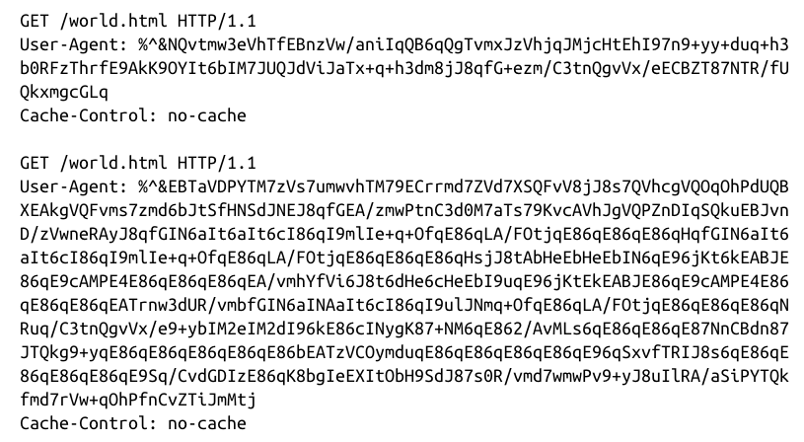
GET and POST
GET for request
POST for send
Used to send a command prompt followed by a directory listing

Slide 42
User Agents
Early malware used strange User-Agent strings
This made it easy to block
Valid user agent:

Slide 43
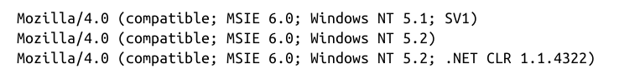
3 Possible User Agents
Malware alternates between these to defeat detection

Slide 44
Use Existing Infrastructure
A server only servicing malware requests, it will be more vulnerable to detection
Use a server used for legitimate purposes to cloak malicious uses.
Investigation of the IP address will also reveal the legitimate uses.

Slide 45
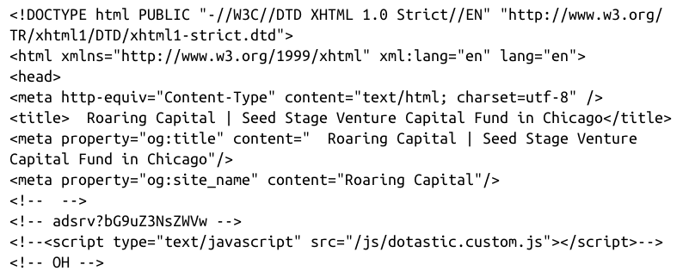
Attackers Use Existing Infrastructure
Botnet commands concealed in source code of a Web page

Slide 46
Leveraging Client-initiated Beaconing
Hosts behind NATs or proxy servers have a concealed IP address
Makes it difficult for attackers to know which bot is phoning home
Beacon identifies host with an unique identifier
Such as an encoded string with basic information about the host

Slide 47
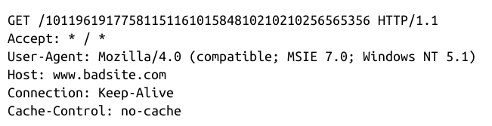
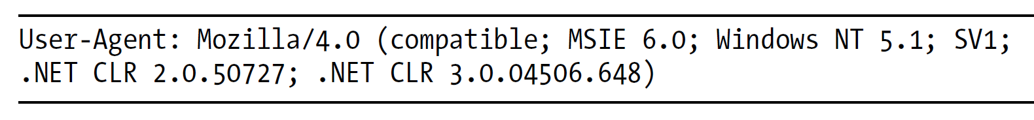
Understanding Surrounding Code
Malware beacon
The standard User-Agent using IE
Notes:
User-Agent is very common, URI is suspicious.

Slide 48
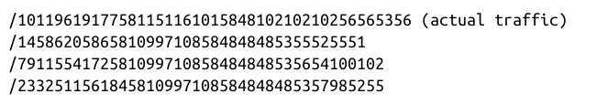
Understanding Surrounding Code
Running the malware a couple more times.
URIs
Static analysis can be used to figure out exactly how the request is being created.

Slide 49
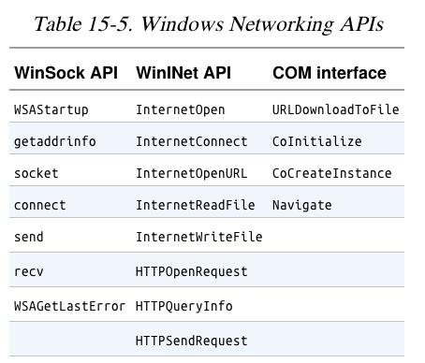
Finding the Networking Code
The HTTPOpenRequest parameter is the URI path
The URI are generated
from calls to GetTickCount, Random, and gethostbyname.

Slide 50
Sources of Network Content
The hard-coded data from the malware are most valuable for signature generation
Require knowledge of the origin of each piece of network content

Slide 51
Sources of Network Content
Random data
Data from networking libraries
Such as the GET created from a call to HTTPSendRequest
Hard-coded data
Data about the host and its configuration
Hostname, current time, CPU speed
Data received from other sources
Remote server, file system, keystrokes

Slide 52
Hard-Coded vs. Ephemeral Data
Malware using lower-level networking APIs such as Winsock
Requires more manually-generated content to mimic common traffic
More hard-coded data
Likely the author makes a mistake that leaves a signature in the network traffic
May misspell a word like Mozilla(Mozila, MoZilla)

Slide 53
How URI is Generated
Convert bytes to its ASCII decimal form (for example, the character a becomes 97).
Develop an effective regular expression for the URI.

Slide 54
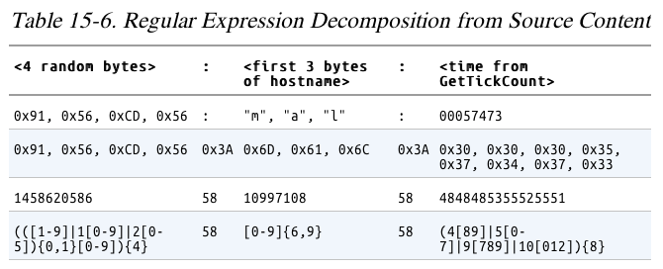
Identifying and Leveraging the Encoding Steps

Slide 55
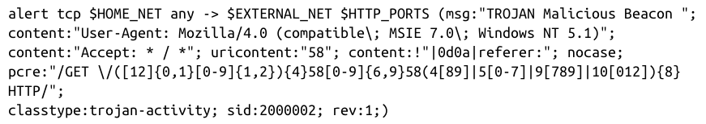
Creating a Signature
Avoid excessive complexity
Slows down the IDS
Include enough detail to eliminate false positives

Slide 56
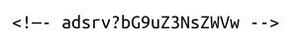
Analyzing the Parsing Routines
The communication in two directions
The traffic that the malware generates
The traffic that the malware receives
Malware strings and the Web page comments both include the common string adsrv?

Slide 57
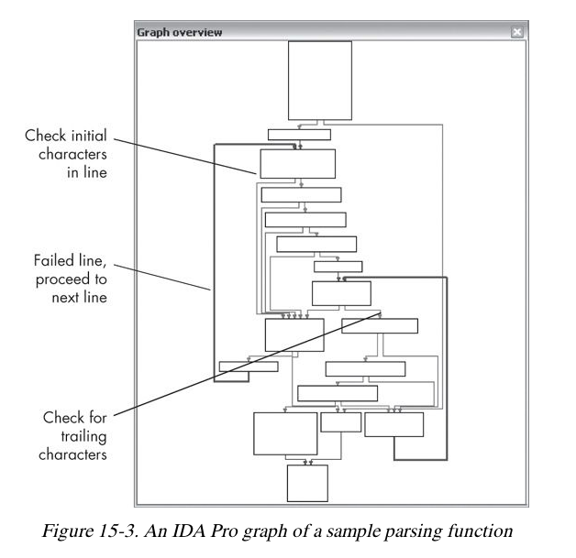
Deep analysis to find potential additional elements
Parser looks for 3 elements
<!—
text
-->

Slide 58
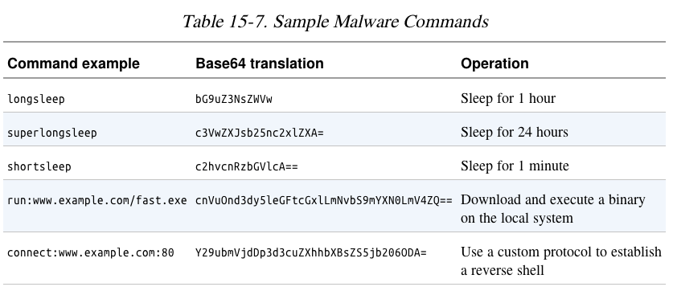

Slide 59
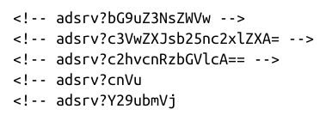
Possible Signatures
The five possible commands
These will work, but any change in the malware will evade them

Slide 60
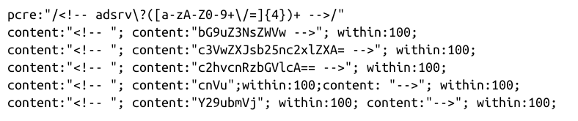
Targeting Multiple Elements
These are more general
The first one accepts any Base64 in a comment with the adsrv prefix

Slide 61
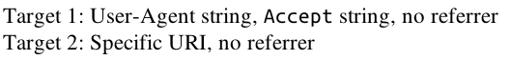
Making General Signatures

Slide 62
Understanding the Attacker's Perspective

Slide 63
Rules of Thumb
高质量的特征：从攻击者角度，绕过比较困难
Focus on elements of the protocol that are part of both end points
Look for elements that use code on both the client and server
It will be hard for the attacker to change them both

Slide 64
Rules of Thumb
Focus on elements of the protocol known to be part of a key
Such as a User-Agent that identifies bot traffic
Again, it would require updating both ends to change
Identify elements of the protocol that are not immediately apparent in traffic
This will be less likely to be used by other, sloppy, defenders who leak info to the attacker

Slide 65
本章知识点
网络应对措施（Network Countermeasures）
网络事件调查（Safely Investigate an Attacker Online）
基于内容的防治（Content-Based Network Countermeasures）
动静结合分析（Combining Dynamic and Static Analysis Techniques）
攻击者角度分析（Understanding the Attacker’s Perspective）

Slide 66
恶意代码分析与防治技术 第14章: 恶意代码网络行为分析
王志
zwang@nankai.edu.cn
南开大学 网络空间安全学院
2023-2024学年

